Slide 1


FA-4 PROJECT AWD CS163
By-CSE G35-1
Date-14 May,2021
Batch-G35
Sesion-2020-2021

Slide 2

Project Title –
Website for Ministry of Defense

Slide 3

TEAM MEMBERS

Slide 4
Name | Roll Number | Group
Anuvrat Nijhawan | 2010993712 | G35
Dhruv Arora | 2010993701 | G35
Arpit Tyagi | 2010993698 | G35
Pranjal Tyagi | 2010993727 | G35

Slide 5
High Level Approach
Followed

Slide 6

• The project website is having interactive and user-friendly pages which we have created using technologies like Bootstrap, JS to facilitate navigation across the website.

Slide 7
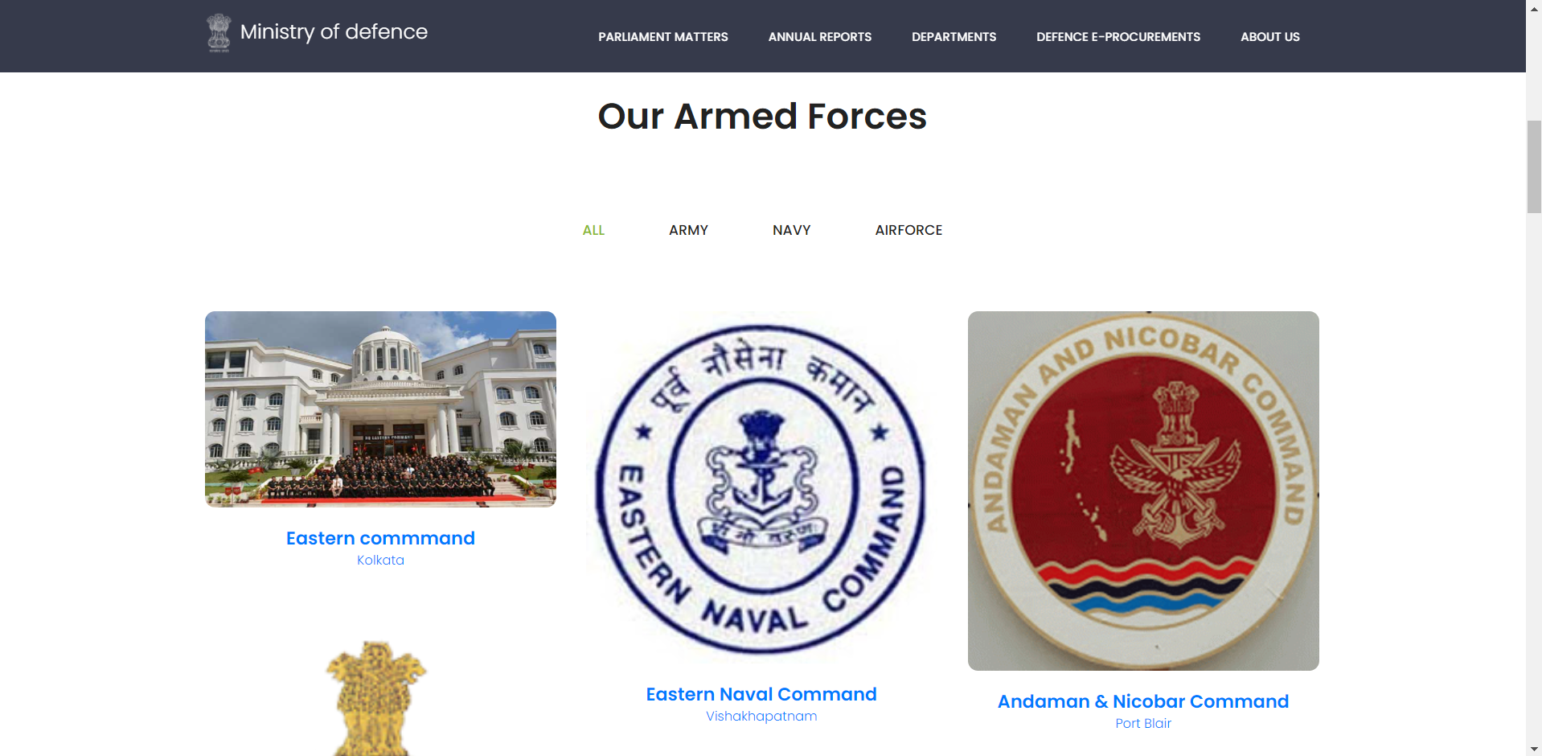
• The home page of our proposed website is an interactive platform which provides access to various portals of GoI and also the access to the various twitter and information handles of separate commands and branches of our armed forces and other important organizations.

Slide 8

• Our proposed website also provides direct access to many of the government portals which the user may seek for various RTI related wok as to make the system more efficient.
• Our website also provides a single point reach to Government of India’s Defense e-Procurement portal to facilitate the e-Tendering processes.

Slide 9
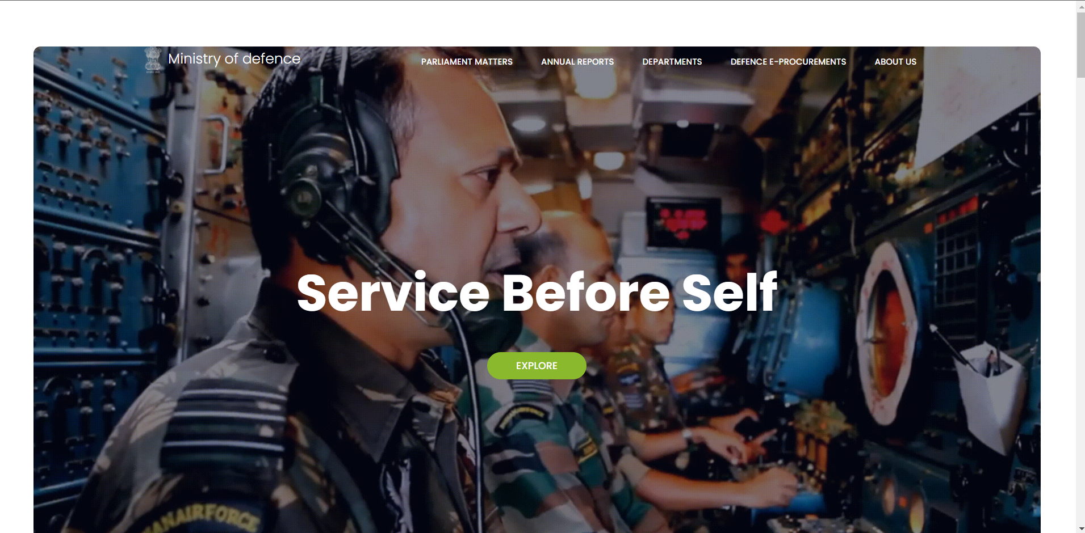
• Our proposed website rightly showcases the courage, valour and dedication of our armed forces through various stirring videos and images.

Slide 10
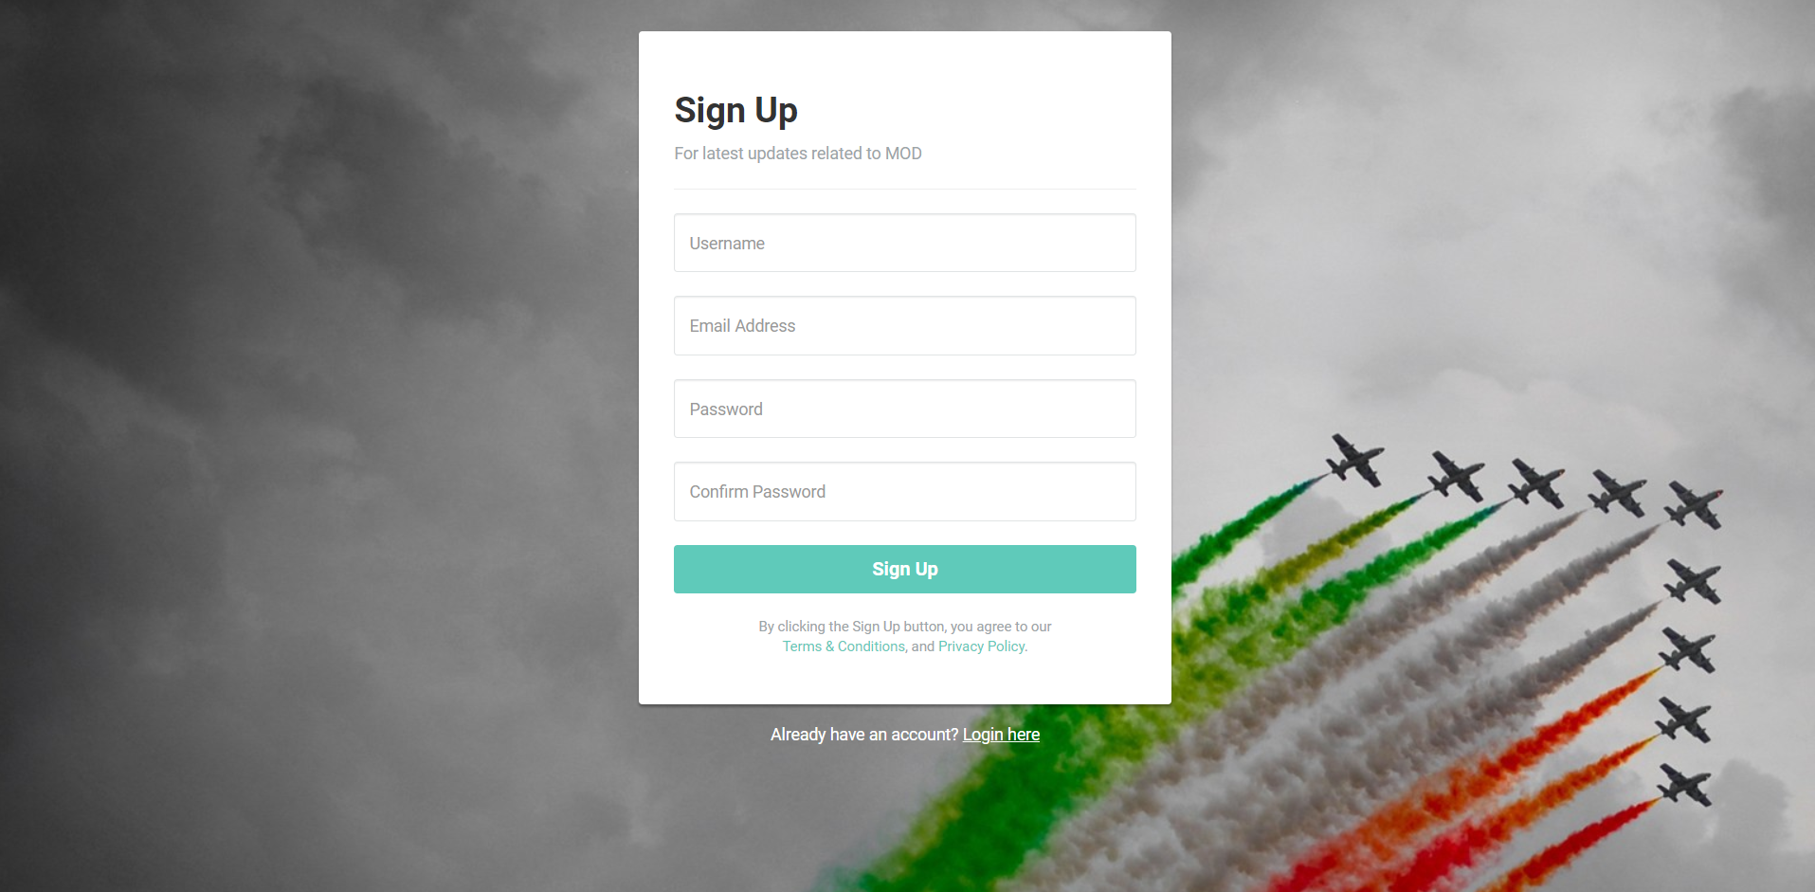
• Our proposed website also contains a sign-up page which helps the user to register with the MoD in order to receive latest updates about MoD and also about the new e-tender releases.

Slide 11
Low Level Approach
Followed

Slide 12
User case 1: Our project website is having an interactive and graphic based orientation which captures user’s mind with a stirring video that is played using an external CSS file and also it has interactive navbar which we have created using Bootstrap & CSS whose property helps it to remain visible even when the user scrolls down through the website.
User case 2: In our project website user can select any of the buttons present in the navbar and also the various command pictures in order to gain access to the related resources.
User case 3: Our project website also allows the user to access various resources through buttons present in navbar and all across the home page and in the pages inside which are in public domain and can be used by the citizens in order to ensure the transparency in the system and also for the quest for knowledge.

Slide 13
User case 4: Our project website also allows the user to access the e-tendering portal of the government with the help of the button available in the navbar and thus provides a single point access for the e-defense procurements.
User case 5: Our project website showcases the efforts that our armed forces make in order to keep our nation safe from the enemies. Interactive and stirring videos are made available on the home screen using the CSS properties and also the explore button in the center of the video provides the direct access to the linked ADGPI YouTube channel of Indian army.
User case 6: Our project website provides an exclusive for feeds button which redirects to a separate sign-up and login page which helps the user to register with the MoD website and gain access to all the recent updates and defence related e-tenders via e-mail. The sign-up page comes loaded with features like warnings on wrong inputs etc.

Slide 14
Advantage of the project with applicability

Slide 15
Our proposed website contains various linked addresses of separate commands and branches of our armed forces of our nation in order to facilitate more of civilian and uniform collaboration to take our defense mechanisms a level ahead.
With interactive and user-friendly graphics, our website also turns out to be a great knowledge and learning platform from where we can educate the youth of our country more about our defense related matters and our armed forces.

Slide 16
Schedule for implementing the use case

Slide 17
Deliverable | Expected Date of Completion
Home Page | 4 May 2021
About Us | 28 April 2021
Parliament Matters | 12 April 2021
Annual Reports | 5 April 2021
Sign-Up page | 16 April 2021

Slide 18
Future scope of the project

Slide 19
Our proposed website can help the government to develop an interactive user-friendly platform so that the matters of public interests related to the MOD could be easily accessed in order to bring more transparency in our system.
Our project also aims to develop an interactive and informative interface to help the citizens explore more about their armed forces and thus can take pride in their valour.
Our project also aims to facilitate and simplify the e tendering process in order to bring more transparency and also to help the dream of a digital and efficient India come true.

Slide 20
Document History

Slide 21
Created By | Anuvrat Nijhawan, Dhruv Arora, Arpit Tyagi, Pranjal Tyagi
Approved By | Associated faculty name (to be approved before the external viva)
Month of Creation | May 2021

Slide 22


